Slide 1
Max plan
Ciaran cordial

Slide 2
Concept
In our modern world, life is going by us at an alarming pace. It can be difficult to manage all the tasks that need to be done.
Stress levels have raised in 6 out of 10 workers in significant economies.
Time is the most valuable resource which we can never get back.
It is crucial to maximize its efficiency.
An easily useable program needs to be designed to help people handle their daily lives and become more efficient and reduce stress.

Slide 3
Design
The user will input their different tasks into the program
Different classifications can be used.
School/Work/Personal/Events
The program will then determine the most effective using simulated annealing using priority as the energy to figure out the best course.
The program will output what will be the most effective way to complete each task while also not piling all “hard” tasks back to back to reduce stress.

Slide 4
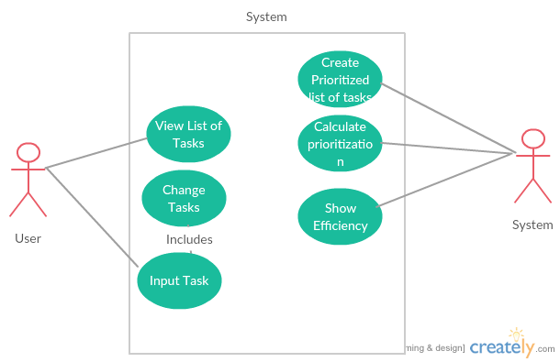
USE Case diagram

Slide 5
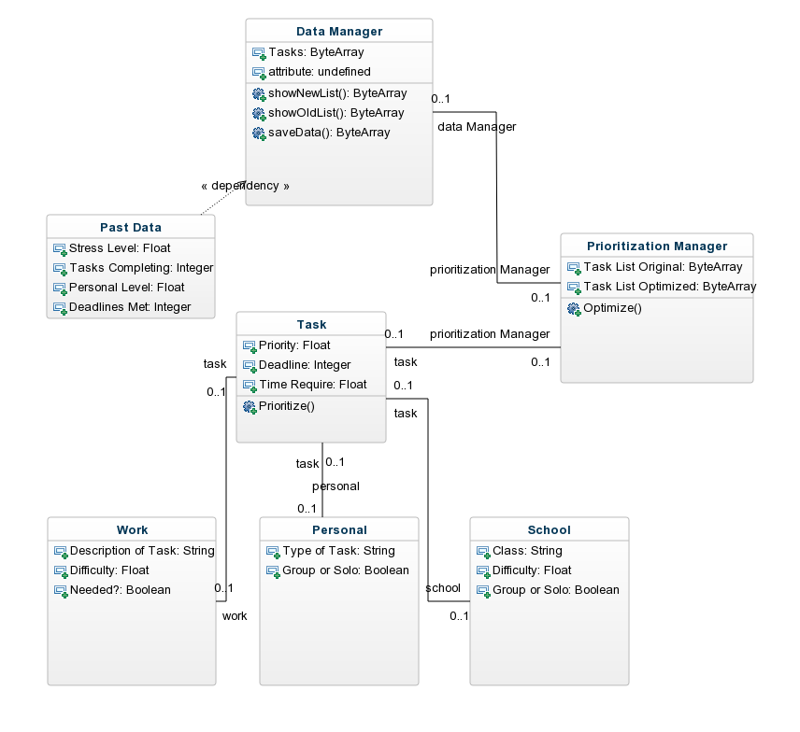
Class diagram

Slide 6
Possible updates
This can be an app on a phone, an application on a computer, or even a script running on a website. This will allow for a lot of feed back for improvements on the system.
Because of this, the concept is simple enough with clear split cases so that changing and updating will be simple to do.

